Slide 1
Day 5

Slide 2
Task
Map the vCenter iso to windows 2012 R2 vm
Try to configure mail server in vsphere
Try to find out hardware status in vSphere vCenter
If task is completed please confirm in chat

Slide 3
Agenda
Hostprofile
Access management
VMware Update Manager

Slide 4
Host profile
Capturing the esxi config info
Vmkernel configuration
Nfs configuration
Iscsi configuration
DVS configuration
Stores the info in vCenter DB
Next host comes up or some make changes in the host
Attach the host profile and reapply it

Slide 5
Auto Deploy and host profile
Centralized server
Image of esxi store on auto deploy server
DHCP (boot from network) the esxi host
DHCP server must be running in env, (MAC address) of host and ip must be registered on DHCP server
vCenter Server: Connect ESXi to vCenter server
Apply host-profile
Vmkernel
Nfs
Iscsi

Slide 6
Host profile ops
Extract
Attach
Check compliance
Apply host profile

Slide 7
Max config info for vmware vSphere
https://configmax.vmware.com/guest?vmwareproduct=vSphere&release=vSphere%206.5&categories=1-0

Slide 8
Access control
When a production env:
Can not admin rights to everyone
Administrator@vsphere.local default user
Use case
30 member are sharing single vCenter
Logging using local user
We cannot track activity
Add the vCenter to Domain
Domain user level we should provide the access to vCenter
Will be able to login using my domain user
Roles we have to provide to domain users
Readonly
Admin
Api one
Customize

Slide 9
Task (20min)
Create a virtual machine user role
Create a user in vsphere.local : vmuser user name
Assign that role to the user
Logout from administrator
Login using vmuser
What activity you can perform

Slide 10
Lockdown mode
In normal lockdown mode the DCUI service is not stopped. If the connection to the vCenter Server is lost and access through the vSphere Web Client is no longer available, privileged accounts can log in to the ESXi host's Direct Console Interface and exit lockdown mode.
In strict lockdown mode the DCUI service is stopped. If the connection to vCenter Server is lost and the vSphere Web Client is no longer available, the ESXi host becomes unavailable unless the ESXi Shell and SSH services are enabled and Exception Users are defined.

Slide 11
Swap file location
Swap file for vm memory (If we are not providing the reservation
Swap file we store in vm directory only
Production env :want to store on ssd
Have option to create swap on ssd
Option :Configure->VM->VM swap file

Slide 12
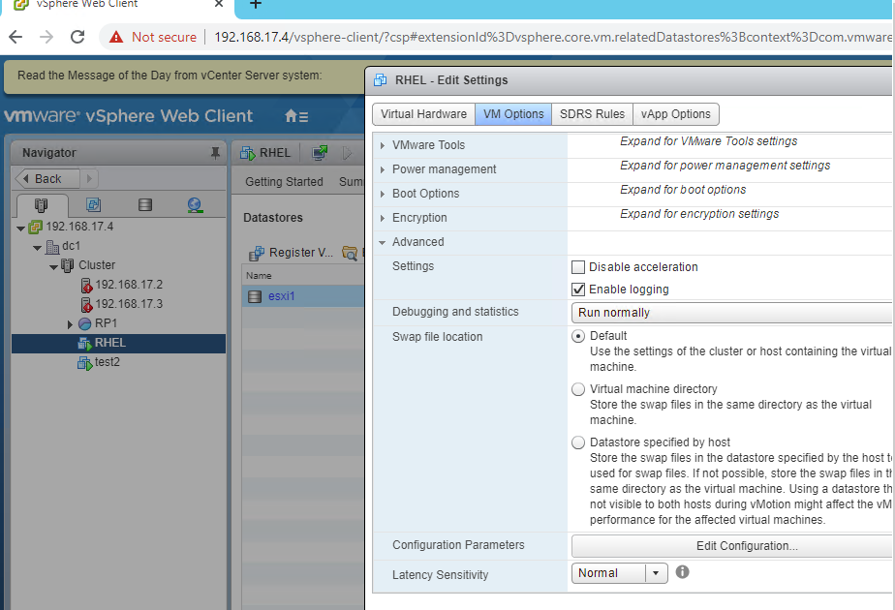

Slide 13
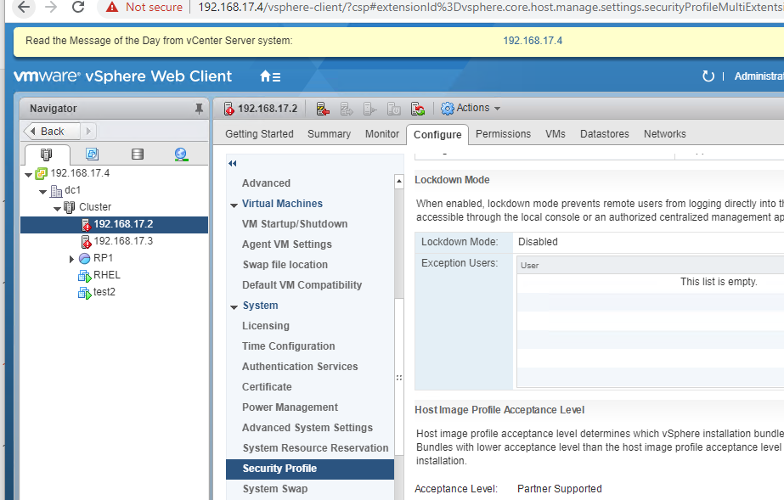

Slide 14
Affinity rule
ESXi -1 and ESXi-2
Running Microsoft cluster vms :vm1 and vm2
Need to set a rule that
Vm1 must be always on esxi 1
Vm2 must be always on esxi2
In other terms, they should not be together on same host
This is called affinity rule

Slide 15
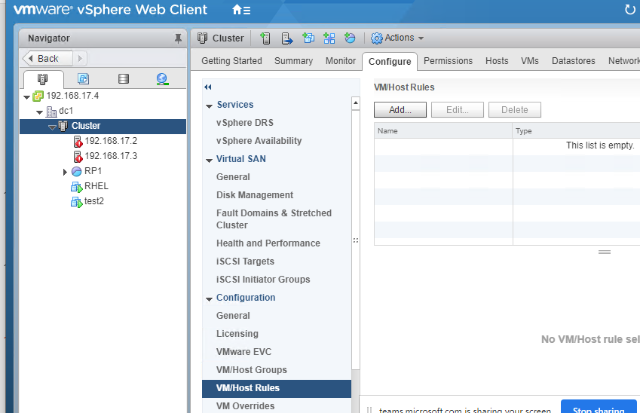

Slide 16
Update Manager (VUM):VMware vSphere update manager
ESXi installed
Issue occurred it crashed
VMware provide some fix
Fix will in-form path or update
Need to apply the fix
Login to induvial host and apply patch
60 ESXi
Two SA apply the patch
Login to each server and apply it
Tracking is difficult
To answer this prob, vmware has come up :

Slide 17
How it will help
Apply multiple host patches together
Management is easy
Multiple patch line can be created
Patch1
Patch2
Stage and remediate it
When ever we apply patch from vum, first it has to copy the bundle to esxi host, that is called staging

Slide 18
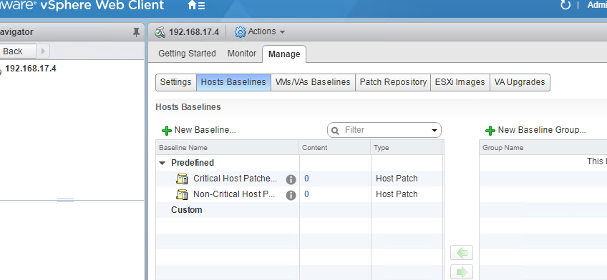
..

Slide 19
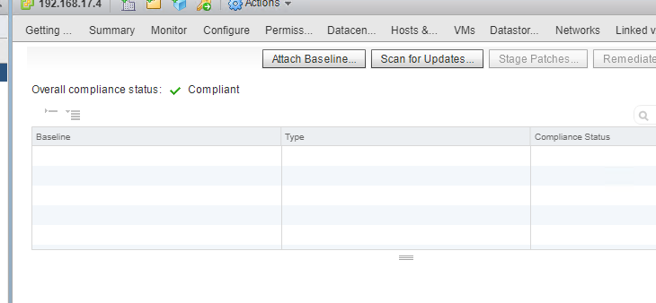
..

Slide 20
VMware vSphere services
https://docs.vmware.com/en/VMware-vSphere/6.5/com.vmware.vsphere.install.doc/GUID-78933728-7F02-43AF-ABD8-0BDCE10418A6.html

Slide 21
Task
Delete Datacenter
Delete cluster
Delete both esxi host
create two new esxi
Provide 4 nic cards
Provide 8 gb ram and 4 vpcu, harddisk size 100 gb
Use 192.168.17.2 and 192.168.17.3
Enable ssh and shell mode from dcui
Create rhel6 vm(50gb) and create nfs share
- Windows vm10 nfs partition
Create new dc
Add host
Enable vmotion
Create ha/drs cluster
Map new nfs share both host
Create dvs and add uplink for both host
create software iscsi adapter
Create new content library
Move template
Create vm from template
Enable strict lockdown
try to access esxi from putty

